Slide 1
AUTOMATIC WATER LEVEL CONTROLLER
- Using Aurdino
V SANJANA
CB.SC.U4CSE23751
LINK: https://wokwi.com/projects/413080809543126017

Slide 2
OBJECTIVES OF THE SENSOR
The main objective of the sensor in the code above is to
Measure - the water level in a tank .
Automate pump - control based on predefined thresholds to maintain an optimal water level.
Monitor Water Level - The ultrasonic sensor measures the distance to the water surface, calculating the water level as a percentage relative to a threshold.
2.Control Pump Automatically:
In AUTO mode, the pump is turned ON if the water level drops below 30% and turned OFF if it reaches or exceeds 100%.
In MANUAL mode, the pump state can be toggled manually.
3. Display Information: The LCD shows the current water level percentage, pump status (ON/OFF), and operational mode (AUTO/MANUAL), providing real-time feedback for easy monitoring.

Slide 3
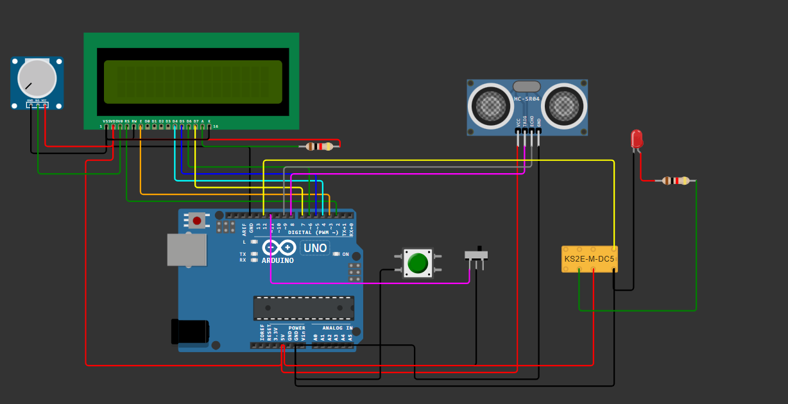
CIRCUIT DESIGN AND COMPONENTS REQUIRED
LCD Display
Resistors
Pressure sensor
Potentiometer
Push button
LED
Slide switch
Aurdino UNO
DPDT Relay

Slide 4
ALGORITHM
1.Initialize:
Set up the LCD, sensor, buttons, and pump control pins.
Read the initial water level threshold from memory (EEPROM) limiting it to a maximum value of 150.
2.Measure Water Level:
Send an ultrasonic pulse and calculate the water level in inches from the echo received.
Convert this level to a percentage based on the set threshold.
3.Display Water Level and Pump Status:
Show the water level percentage on the LCD.
Display whether the pump is ON or OFF and the current mode (AUTO/MANUAL).
4.Control Pump:
AUTO Mode:
Turn the pump ON if the water level is below 30%.
Turn the pump OFF if the water level reaches or exceeds 100%.
MANUAL Mode:
Allow the pump to be toggled ON or OFF manually with a button.
5.Set New Threshold (Only in AUTO Mode):
If the "set" button is pressed, update the water level threshold based on the current measurement and save it to memory
6. Repeat:
Wait for a short delay and repeat the measurement and control steps.
This loop continues, ensuring real-time monitoring and control of the water level and pump status.

Slide 5
C CODE
#include <EEPROM.h>
#include <LiquidCrystal.h>
// Initialize LCD with the specified pin configuration
LiquidCrystal lcd(2, 3, 4, 5, 6, 7);
// Structure to hold water level data
struct WaterLevelData {
long inches;
int set_val;
int percentage;
};
// Create an instance of the structure
WaterLevelData waterLevel;
// Pointer to the waterLevel structure
WaterLevelData *waterLevelPtr = &waterLevel;
long duration;
bool state, pump;
void setup() {
lcd.begin(16, 2);
lcd.print("WATER LEVEL: ");
lcd.setCursor(0, 1);
lcd.print("PUMP:OFF MANUAL");
// Set pin modes for pins 8 to 12
for (int pin = 8; pin <= 12; ++pin) {
if (pin == 8 || pin == 12) {
pinMode(pin, OUTPUT);
} else {
pinMode(pin, INPUT_PULLUP);
}
}
waterLevelPtr->set_val = EEPROM.read(0);
if (waterLevelPtr->set_val > 150) {
waterLevelPtr->set_val = 150;
}
}
void loop() {
digitalWrite(3, LOW);
delayMicroseconds(2);
digitalWrite(8, HIGH);
delayMicroseconds(10);
digitalWrite(8, LOW);
duration = pulseIn(9, HIGH);
// Calculate and display inches and percentage values using pointers
waterLevelPtr->inches = microsecondsToInches(duration);
waterLevelPtr->percentage = (waterLevelPtr->set_val - waterLevelPtr->inches) * 100 / waterLevelPtr->set_val;
// Display the percentage value on LCD
lcd.setCursor(12, 0);
if (waterLevelPtr->percentage < 0) waterLevelPtr->percentage = 0;
lcd.print(waterLevelPtr->percentage);
lcd.print("% ");
// Pump control logic based on water level percentage using pointer
if (waterLevelPtr->percentage < 30 & digitalRead(11)) pump = 1;
if (waterLevelPtr->percentage > 99) pump = 0;
digitalWrite(12, !pump);
// Display pump status on LCD
lcd.setCursor(5, 1);
if (pump == 1) lcd.print("ON ");
else if (pump == 0) lcd.print("OFF");
// Display mode status on LCD (MANUAL or AUTO)
lcd.setCursor(9, 1);
if (!digitalRead(11)) lcd.print("MANUAL");
else lcd.print("AUTO ");
// Adjust threshold if button is pressed in AUTO mode
if (!digitalRead(10) & !state & digitalRead(11)) {
state = 1;
waterLevelPtr->set_val = waterLevelPtr->inches;
EEPROM.write(0, waterLevelPtr->set_val);
}
// Toggle pump if button is pressed in MANUAL mode
if (!digitalRead(10) & !state & !digitalRead(11)) {
state = 1;
pump = !pump;
}
// Reset state when button is released
if (digitalRead(10)) state = 0;
delay(500);
}
// Function to convert microseconds to inches
long microsecondsToInches(long microseconds) {
return microseconds / 74 / 2;
}

Slide 6
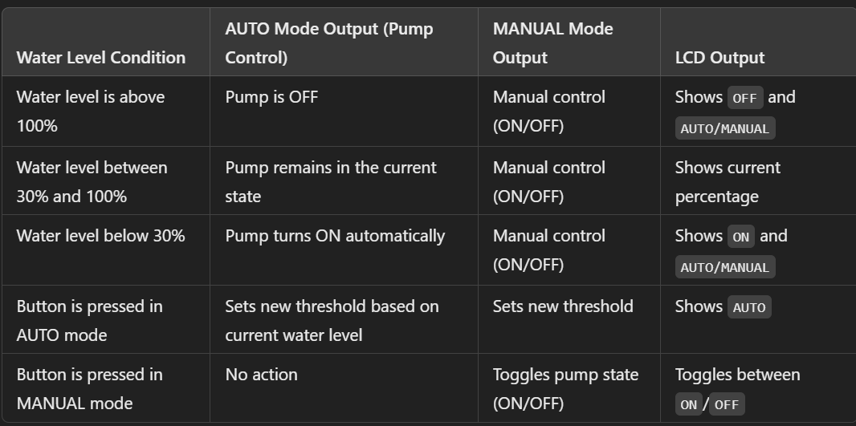
OUTPUT SPECIFICATIONS

Slide 7
Automated Operation Prevention of Overflow and Dry Running
Efficiency and Resource Conservation
Improved Safety
Data Monitoring and Management
ADVANTAGES OF THE ABOVE SENSOR

Slide 8
THANK YOU

